Slide 1


UNODC Committee
Presidents: Maria José Mendez
Maria Alejandra Guativonza

Slide 2
United Nations Office on Drugs and Crime
Global leader in the fight against illicit drugs and international crime.
UNODC operates in more than 150 countries around the world through its network of field offices

Slide 3
. UNODC works closely with Governments and civil society towards building security and justice for all.
Relies on voluntary contributions, mainly from Governments.

Slide 4
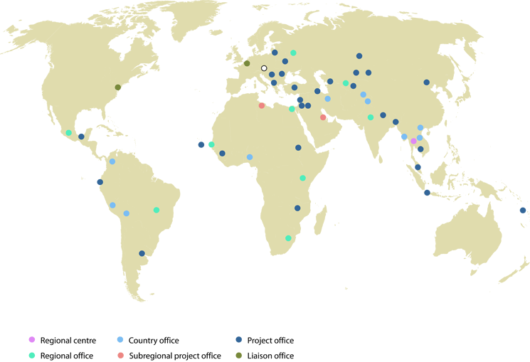

Slide 5
Pillars of the work program
Field-based technical cooperation projects to enhance the capacity of Member States to counteract illicit drugs, crime and terrorism.

Slide 6
Research and analytical work to increase knowledge and understanding of drugs and crime issues and expand the evidence base for policy and operational decisions.

Slide 7
Normative work to assist States in the ratification and implementation of the relevant international treaties, the development of domestic legislation on drugs, crime and terrorism, and the provision of secretariat and substantive services to the treaty-based and governing bodies.

Slide 8
Premise
Should countries accept the fact that marijuana consume has been rising during the last days and legalize its use?

Slide 9
This premise was chosen for the problem we are facing in the world of increase consumption of marijuana, not only as a drug but also as medicinal purposes, is an issue that produce many disputes without considering that people who debate for legalization consume marijuana or not, we must look to the use that is given today.

Slide 10
video
http://www.youtube.com/watch?v=xM0-cZZAegI

