Slide 1

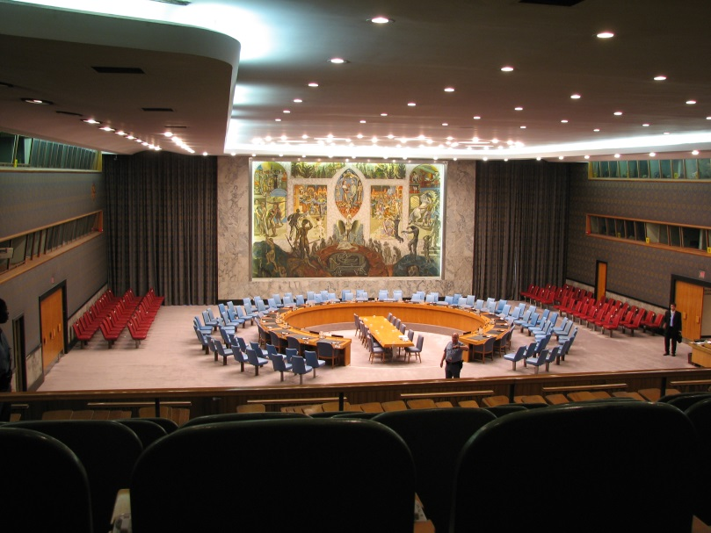

Security Council
GFMUN High School 2013-2014
Felipe Warren – Santiago Arrieta

Slide 2
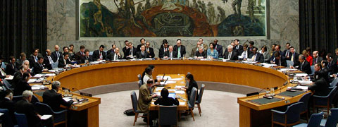
What Is The SC?
The Security Council takes the lead in determining the existence of a threat to the peace or act of aggression. It calls upon the parties to a dispute to settle it by peaceful means and recommends methods of adjustment or terms of settlement. In some cases, the Security Council can resort to imposing sanctions or even authorize the use of force to maintain or restore international peace and security.

Slide 3
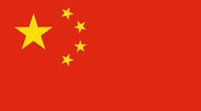



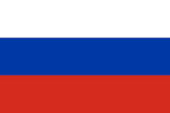
Presidents
Felipe Warren
Santiago Arrieta
Veto:
China
USA
France
UK
Russia

Slide 4
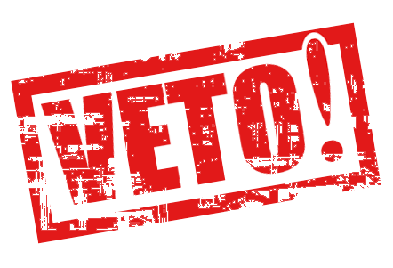
Topic
The decisions in the UN among international peace and security are taken by the Security Council, but 5 delegations have the power of veto which means that their vote is absolute. According to this situation: “Does the Security Council need a reform in the power of veto and the way conflicts are being solved? How can developing countries benefit from this?”

Slide 5

Video

